Slide 1


Slide 2
Software Engineering Report
Project: SeedSchool
Team 507
Team member: Phạm Hải Đăng – 20194736
Nguyễn Bá Hải – 20194753
Hoàng Thanh Lâm – 20194786
Phạm Thành Biên – 20194731
Phạm Anh Minh – 20194802
Hoàng Quang Mạnh – 20194795
Triệu Văn Long – 20194793
Nguyễn Đức Hải – 20194754
Lê Triệu Sáng – 20194829

Slide 3

List of functionalities should be done

Slide 4
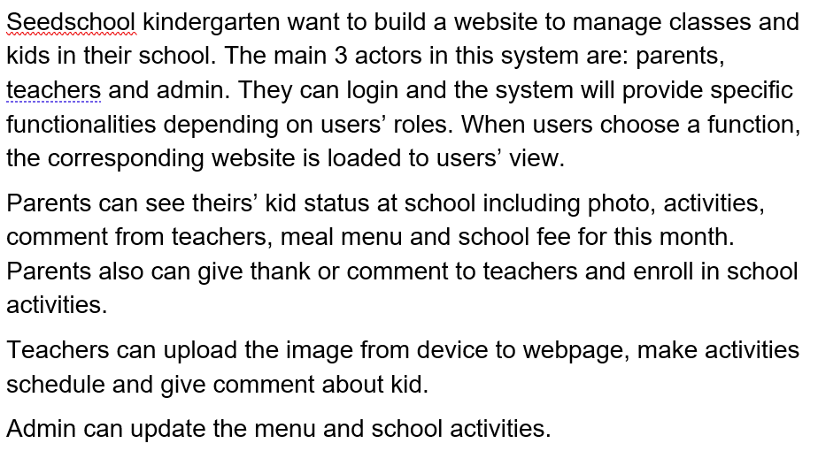
Project overview

Slide 5
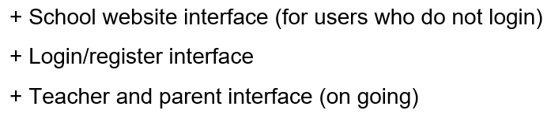
List of functionalities that have been done

Slide 6


The main website
Desktop
Mobile

Slide 7
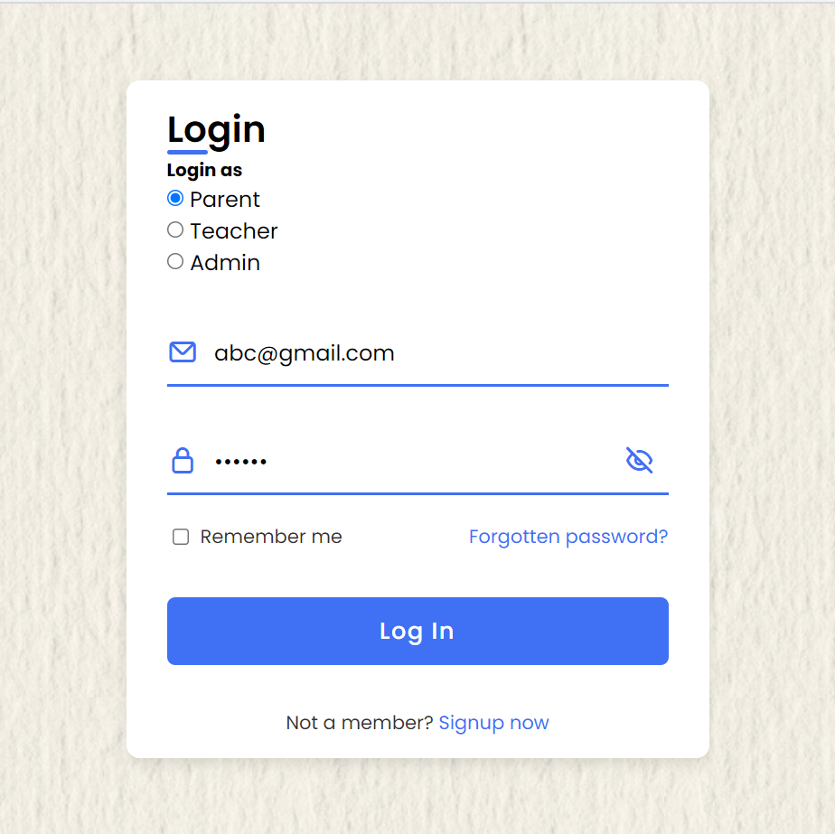
Login webpage

Slide 8
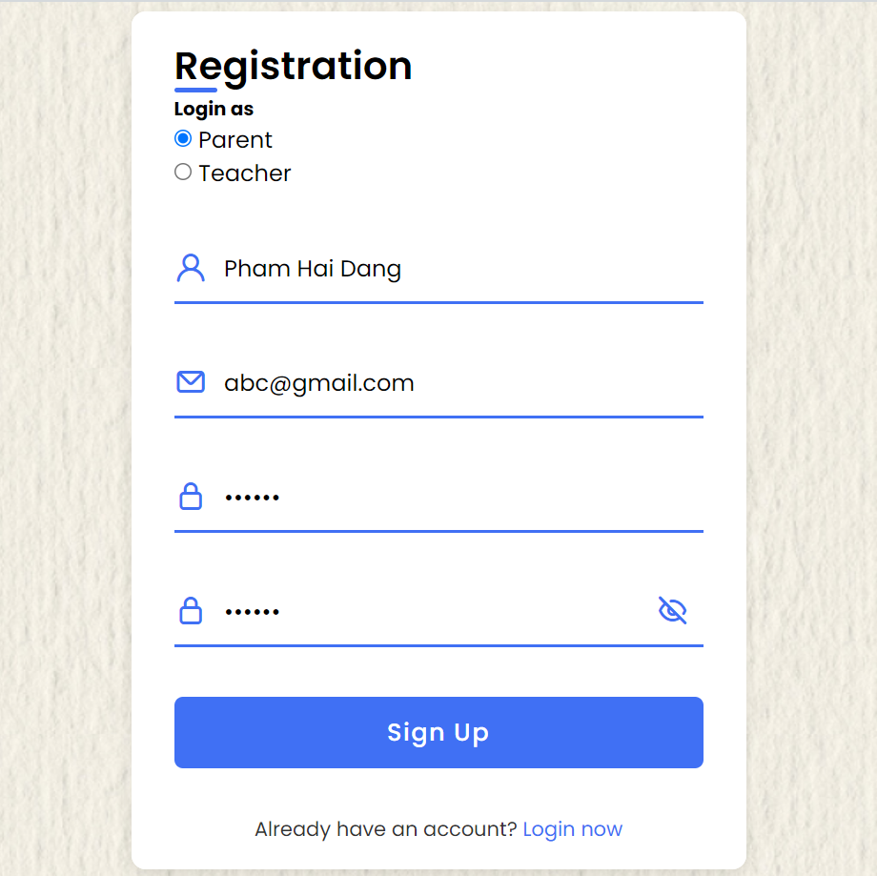
Register webpage

Slide 9
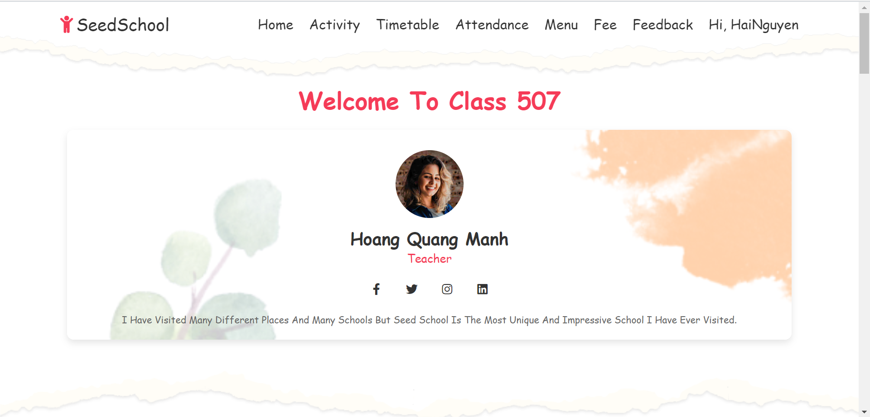
Parent interface

Slide 10
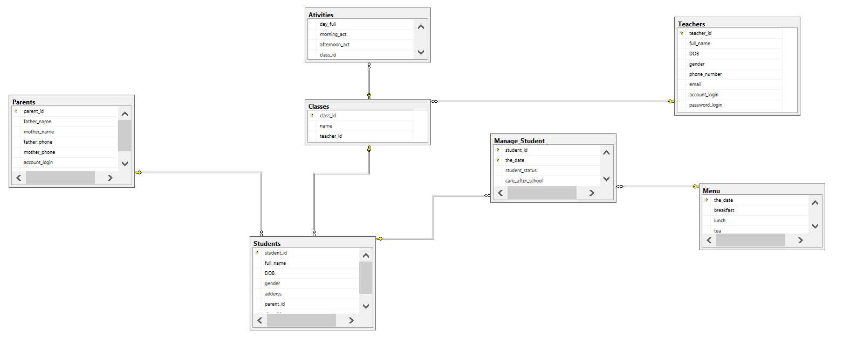
Database

Slide 11
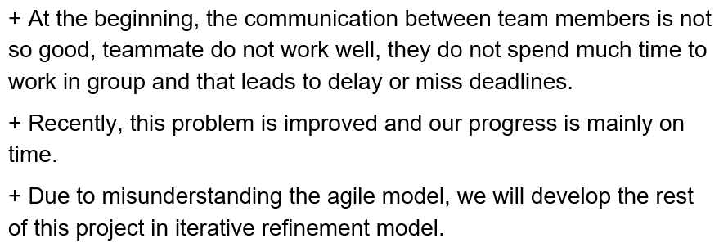
Bugs and problems

Slide 12
Demo project

